Slide 1

Geometry
Unit 9, Lesson 3 Cross Sections Volume 2, pg. 65

Slide 2


Benchmark
MA.912.GR.4.1
Identify the shapes of two-dimensional cross-sections of three-dimensional figures.
volume 2, pg. 65

Slide 3
Integrated Mathematical Thinking and Reasoning Standards
MA.K12.MTR.1.1 Actively participate in effortful learning both individually and collectively.
MA.K12.MTR.2.1 Demonstrate understanding by representing problems in multiple ways.
MA.K12.MTR.4.1 Engage in discussions that reflect on the mathematical thinking of self and others.
MA.K12.MTR.5.1 Use patterns and structure to help understand and connect mathematical concepts.
volume 2, pg. 65

Slide 4

Learning Target
I can identify the shapes of two-dimensional cross sections of three-dimensional figures.
volume 2, pg. 65

Slide 5

Warm-Up
volume 2, pg. 65

Slide 6
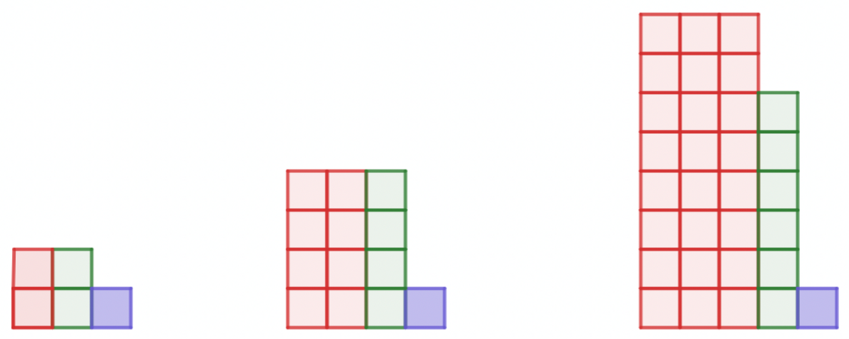
9.3.1 Warm-Up: Patterns
How many red squares are in the seventh pattern?
volume 2, pg. 65

Slide 7

Collaboration
volume 2, pg. 66

Slide 8

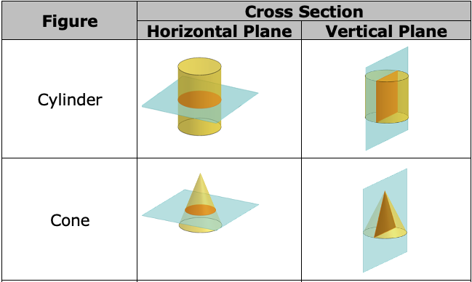
9.3.2 Collaboration: Cross Sections
The table below shows the resulting cross section for each type of slice.
volume 2, pg. 66

Slide 9
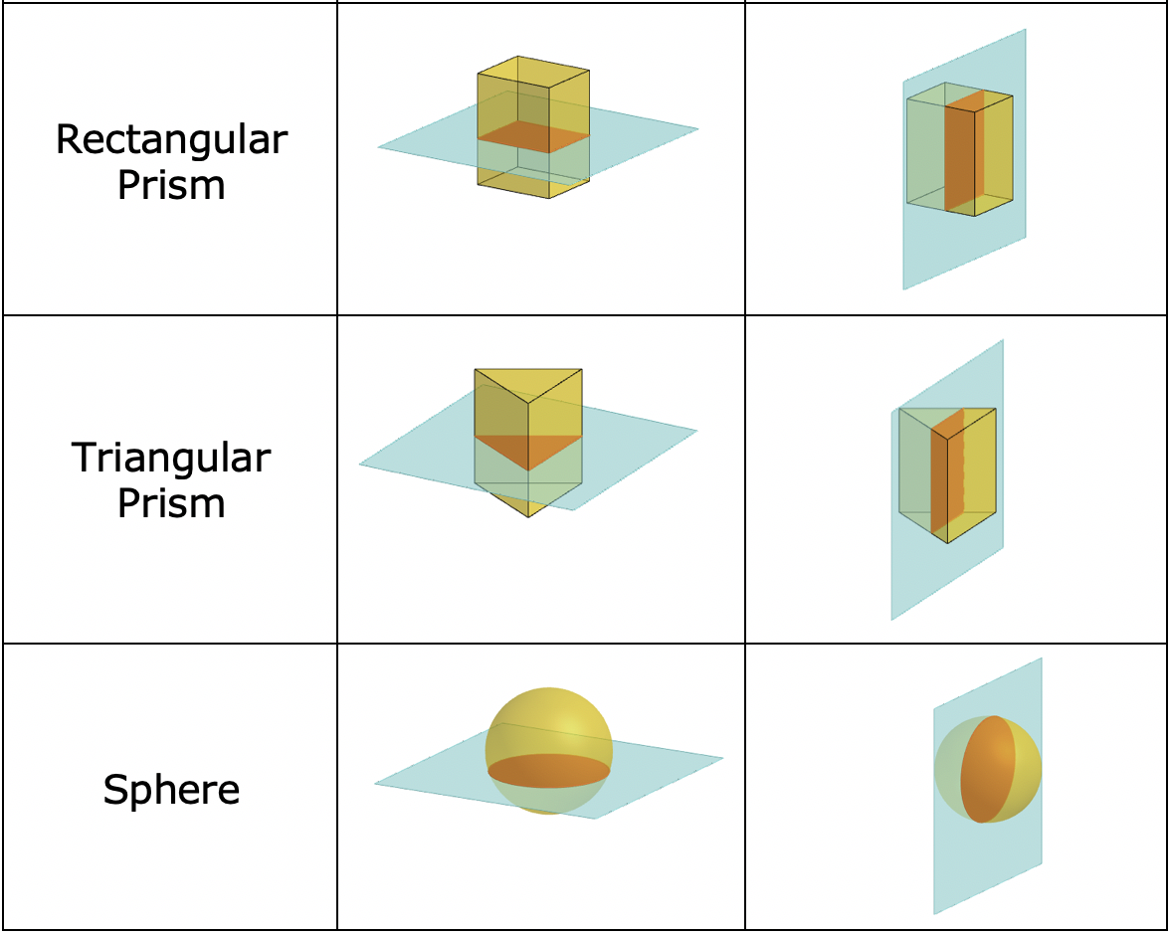
volume 2, pg. 66

Slide 10
What do you notice about the diagrams for horizontal slices?
What do you notice about the diagrams for vertical slices?
Discuss with your partner whether or not the shape of a cross section will change if the height of the plane is changed. Summarize your discussion.
volume 2, pg. 66

Slide 11
Complete the table by describing the shape of the cross section that is created when the figure is sliced by each.
Figure | Cross Section Shape
 | Horizontal Plane | Vertical Plane
Cylinder
Cone
Rectangular Prism
Triangular Prism
Sphere
volume 2, pg. 66

Slide 12

Guided Instruction
volume 2, pg. 67

Slide 13
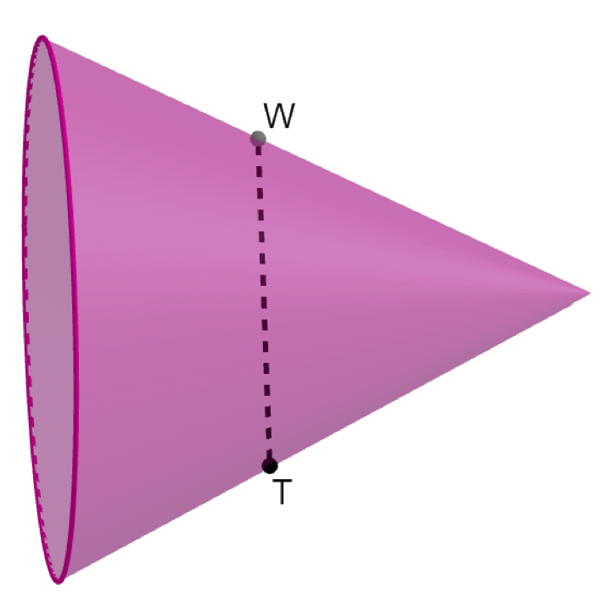
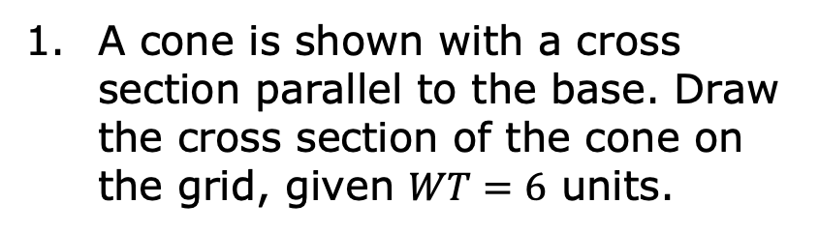
9.3.3 Guided Instruction: Drawing Cross Sections
Three-dimensional figures can be oriented in different ways. Cross sections are typically described by their relation to the base of the three-dimensional figure. For example, cross sections are often described as parallel or perpendicular to the base of the figure.
A cone is shown with a cross section parallel to the base. Draw the cross section of the cone on the grid, given $WT=6$ units.
volume 2, pg. 67

Slide 14
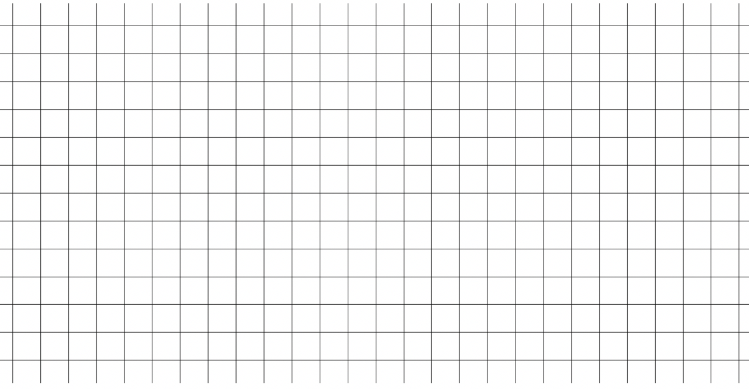
volume 2, pg. 67

Slide 15
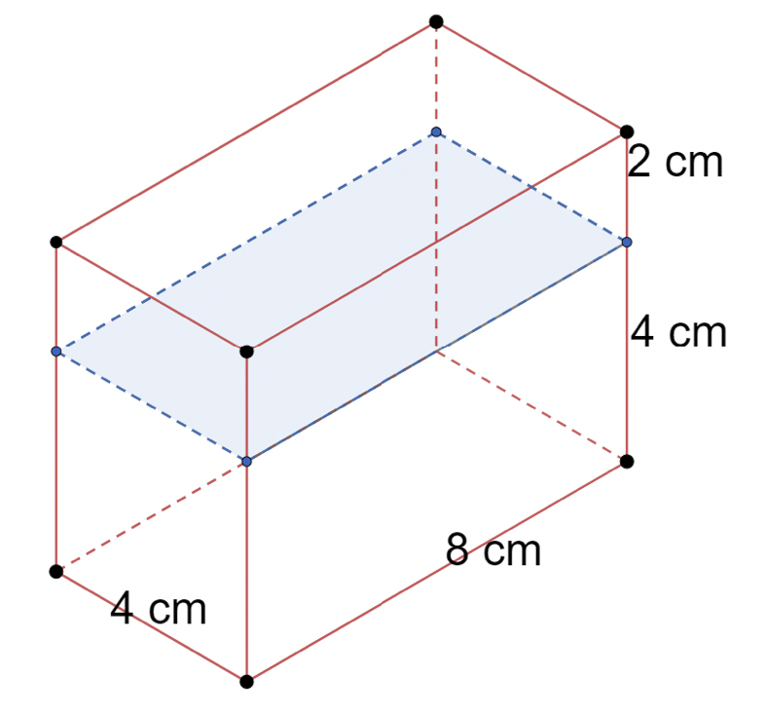
A rectangular prism is shown with a cross section parallel to the base . The dimensions are given in centimeters (cm). Draw the cross section on the grid and label its dimensions.
volume 2, pg. 67

Slide 16
volume 2, pg. 67

Slide 17
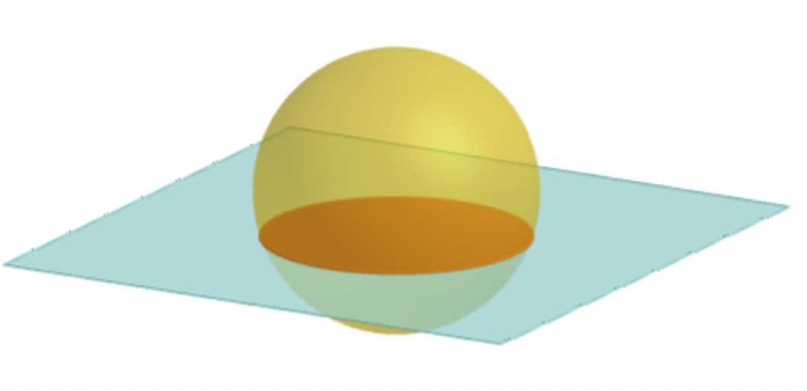

A sphere with radius of 4 inches (in.) with a horizontal cross section is shown.
Draw the cross section if it occurs $\frac{3}{8}$ of the distance from the sphere’s center.
volume 2, pg. 68

Slide 18
volume 2, pg. 68

Slide 19
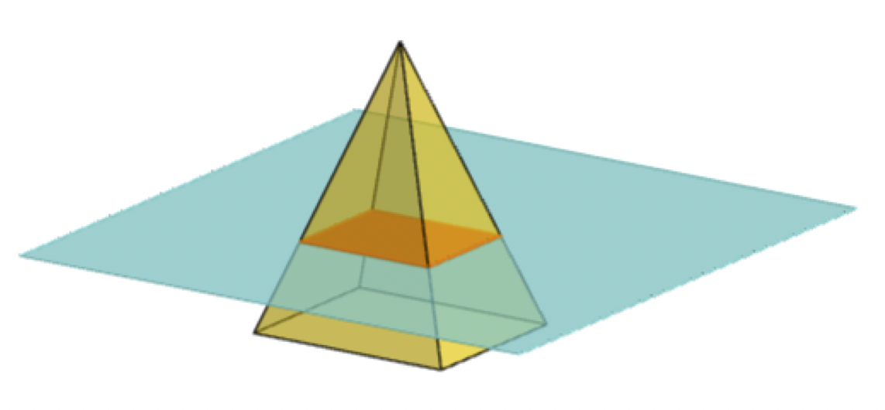

A rectangular pyramid is shown, where the dimensions of the base are $12$centimeters (cm) by $21$ cm and the pyramid’s height is $33$ cm.
Draw the cross section parallel to the base that is located at a height of $11$ cm.
volume 2, pg. 68

Slide 20
volume 2, pg. 68

Slide 21

Your Turn
volume 2, pg. 69

Slide 22
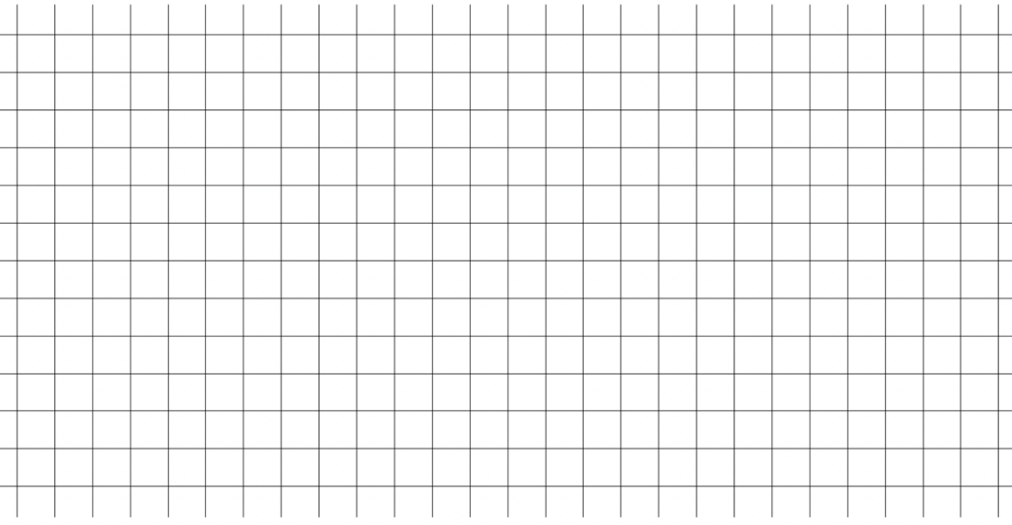
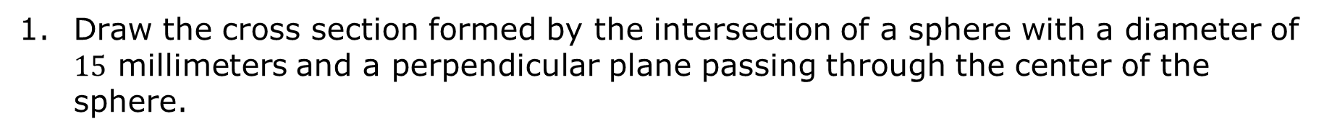
9.3.4 Your Turn!
Draw the cross section formed by the intersection of a sphere with a diameter of $15$ millimeters and a perpendicular plane passing through the center of the sphere.
volume 2, pg. 69

Slide 23
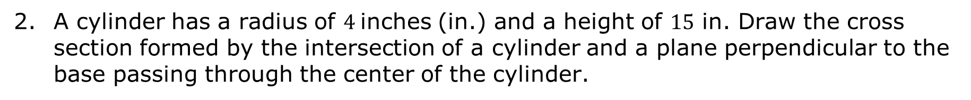
A cylinder has a radius of $4$inches (in.) and a height of $15$ in. Draw the cross section formed by the intersection of a cylinder and a plane perpendicular to the base passing through the center of the cylinder.
volume 2, pg. 69

Slide 24
Draw the cross section formed by the intersection of a pentagonal prism and a plane parallel to the base passing through the prism.
volume 2, pg. 69

Slide 25

Wrap-Up
volume 2, pg. 70

Slide 26
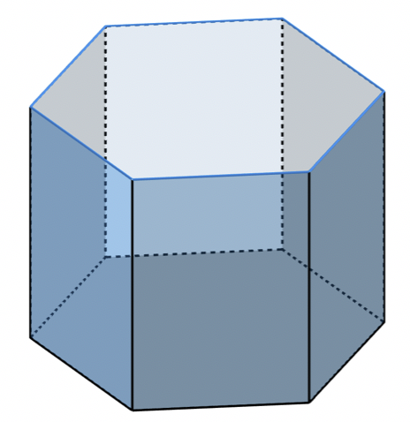
9.3.5 Wrap-Up: Ticket Out the Door
A hexagonal prism is shown.
Draw the cross section that results from a plane that is parallel to the base.
volume 2, pg. 70

Slide 27
volume 2, pg. 70

Slide 28
Draw the cross section that results from a plane that is perpendicular to the base.
volume 2, pg. 70

